Slide 1
C++ is Fun – Part Deux at Turbine/Warner Bros.!
Russell Hanson

Slide 2
Thanks for your patience last time, really
We covered a lot of material quickly
We are going to go back and use some of the topics introduced, slowly, carefully, and with examples you can try out! :)

Slide 3
Getting Familiar with Thinking about Programming
-- Programs can be used to accomplish certain tasks
-- The way that the tasks are accomplished usually consists of a set of instructions
-- The way this set of instructions is carried out uses basic data types like Arrays, Vectors, and Lists
-- Programs are little models of the world
-- They are essentially self-contained, but can interact with outside data, like weather data, stock data, game data, social network data, etc.
-- The data is stored in memory, either persistent like the hard disk, or volatile/non-persistent like RAM.
-- Interacting with a user is often important for a program. Often the user may not know how to interact with the program. The program often needs to check for multiple formats of input, and massage it into the right form for the program to perform its function.
-- A graphical user interface (GUI) can be programmed to allow the user to interact not on the console or command line, but with a more rich visual environment like we are accustomed to.

Slide 4
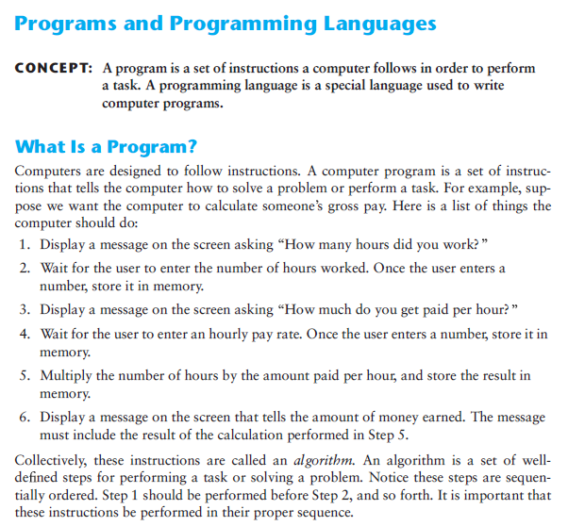

Slide 5
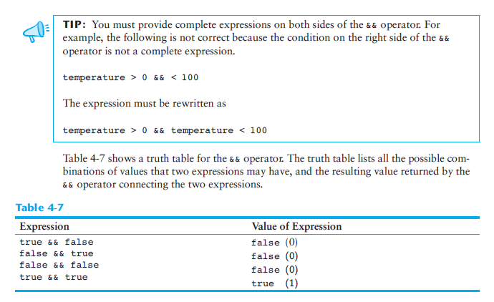
The logical AND operator &&

Slide 6
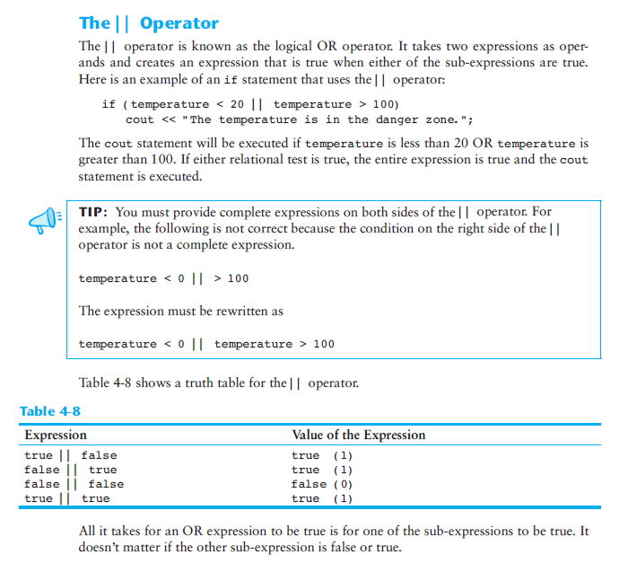

Slide 7
Let’s write a program that uses the OR (||) or AND (&&) operators
#include "stdafx.h"
#include <string>
#include <iostream>
#include <map>
#include <utility>
using namespace std;
int main()
{
string Apple = "Apple";
string Orange = "Orange";
string myitem = "Apple";
if (myitem == Apple || myitem == Orange)
cout << "It's a fruit!\n";
else cout << "It's not a fruit!\n";
string myitem2 = "Cat";
if (myitem2 == Apple || myitem2 == Orange)
cout << "It's a fruit!\n";
else cout << "It's not a fruit!\n";
return 0;
}

Slide 8
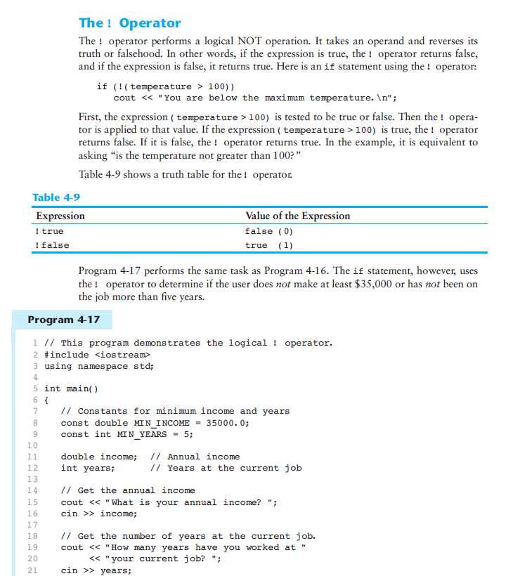

Slide 9
Let’s write a program that uses the NOT or ! or != operator
#include "stdafx.h"
#include <string>
#include <iostream>
#include <map>
#include <utility>
using namespace std;
const int TRUE = 1;
const int FALSE = 0;
int main() {
string Apple = "Apple";
string Orange = "Orange";
if (Apple != Orange)
cout << "That was predictable" << endl;
cout << "Is this false? " << false << endl;
cout << "Is this true? " << true << endl;
while (!FALSE)
cout << "Quite true" << endl;
// Control-C will abort the program
return 0;
}

Slide 10
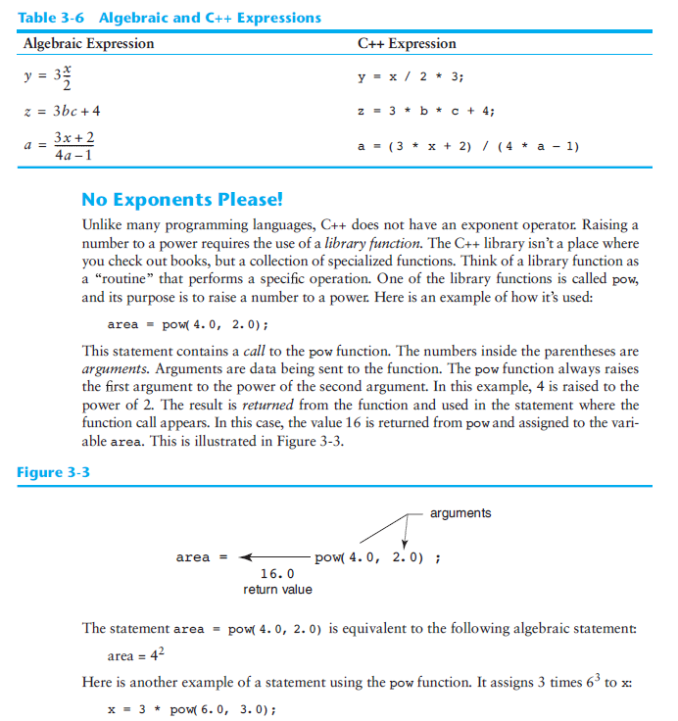

Slide 11
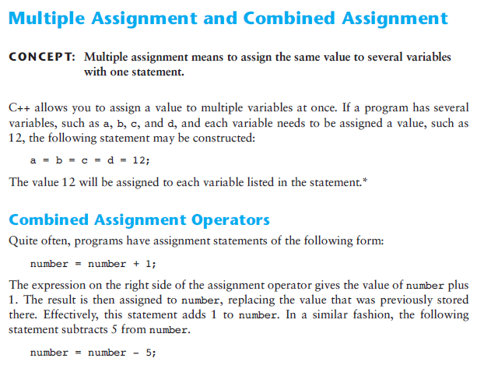

Slide 12
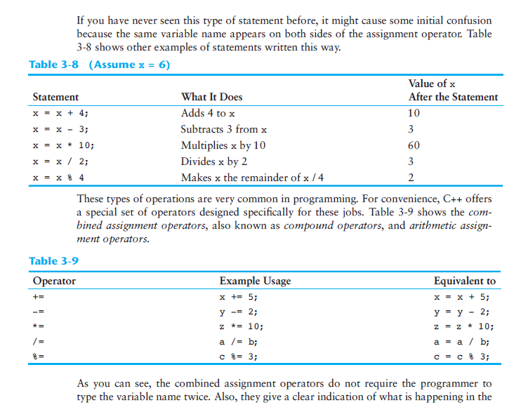

Slide 13
Let’s write a program that uses the modulo operator (remainder) and assigns it to another value
#include "stdafx.h"
#include <string>
#include <iostream>
#include <map>
#include <utility>
using namespace std;
int main()
{
int dividend = 0;
int divisor = 0;
cout << "what's the remainder when you divide:" << endl;
cin >> dividend;
cout << "by:" << endl;
cin >> divisor;
cout << dividend % divisor;
return 0;
}

Slide 14
Return to control structures for, and while
#include "stdafx.h"
// custom countdown using while
#include <iostream>
using namespace std;
int main ()
{
int n;
cout << "Enter the starting number > ";
cin >> n;
while (n>0) {
cout << n << ", ";
--n;
}
cout << "FIRE!\n";
return 0;
}

Slide 15
For loop
// PartDeux.cpp : Defines the entry point for the console application.
//
#include "stdafx.h"
#include <iostream>
#include <vector>
#include <string>
#include <sstream>
using namespace std;
int main() {
int i = 0;
string myanimal = "Elephant";
for (i=0; i < myanimal.size(); i++)
cout << myanimal[i] << endl;
// cout << myanimal[i] << " ";
}
$ ./PartDeux.exe
E
l
e
p
h
a
n
t

Slide 16
Adding data to vectors, be careful of the maximum vector size!
// PartDeux.cpp : Defines the entry point for the console application.
//
#include "stdafx.h"
#include <iostream>
#include <vector>
#include <string>
using namespace std;
int main() {
vector<string> myvector;
myvector.push_back("The number is 10");
myvector.push_back("The number is 20");
myvector.push_back("The number is 30");
cout << "Loop by index:" << endl;
int i;
for(i=0; i < myvector.size(); i++){
cout << myvector[i] << endl;
}
cout << "What happens when we try to access an index greater than the vector's size?\n";
cout << "This happens:" << myvector[myvector.size()] << endl;
cout << "Ouch.";
}

Slide 17
Joining two strings together in C++ is called concatenation, use the stringstream
#include <sstream>
#include <string>
std::stringstream ss;
ss << "Hello, world, " << myInt << niceToSeeYouString;
std::string s = ss.str();
#include "stdafx.h"
#include <iostream>
#include <vector>
#include <string>
#include <sstream>
using namespace std;
int main() {
int myInt = 99; string niceToSeeYouString = " nice to see you!";
stringstream ss;
ss << "Hello, world, " << myInt << niceToSeeYouString;
string s = ss.str();
cout << s << endl;
}

Slide 18
Algorithms
Algorithms can be used to sort and to search!
Quicksort
Quicksort is a fast sorting algorithm, which is used not only for educational purposes, but widely applied in practice. On the average, it has O(n log n) complexity, making quicksort suitable for sorting big data volumes. The idea of the algorithm is quite simple and once you realize it, you can write quicksort as fast as bubble sort.
Algorithm
The divide-and-conquer strategy is used in quicksort. Below the recursion step is described: Choose a pivot value. We take the value of the middle element as pivot value, but it can be any value, which is in range of sorted values, even if it doesn't present in the array.
Partition. Rearrange elements in such a way, that all elements which are lesser than the pivot go to the left part of the array and all elements greater than the pivot, go to the right part of the array. Values equal to the pivot can stay in any part of the array. Notice, that array may be divided in non-equal parts.
Sort both parts. Apply quicksort algorithm recursively to the left and the right parts.

Slide 19
Binary search algorithm
Generally, to find a value in unsorted array, we should look through elements of an array one by one, until searched value is found. In case of searched value is absent from array, we go through all elements. In average, complexity of such an algorithm is proportional to the length of the array.
Situation changes significantly, when array is sorted. If we know it, random access capability can be utilized very efficientlyto find searched value quick. Cost of searching algorithm reduces to binary logarithm of the array length. For reference, log₂(1 000 000) ≈ 20. It means, that in worst case, algorithm makes 20 steps to find a value in sorted array of a million elements or to say, that it doesn't present it the array.
Algorithm
Algorithm is quite simple. It can be done either recursively or iteratively:
get the middle element;
if the middle element equals to the searched value, the algorithm stops;
otherwise, two cases are possible:
  searched value is less, than the middle element. In this case, go to the step 1 for the part of the array, before middle element.
  searched value is greater, than the middle element. In this case, go to the step 1 for the part of the array, after middle element.
Now we should define, when iterations should stop. First case is when searched element is found. Second one is when subarray has no elements. In this case, we can conclude, that searched value doesn't present in the array.Examples
Example 1. Find 6 in {-1, 5, 6, 18, 19, 25, 46, 78, 102, 114}.
Step 1 (middle element is 19 > 6): -1 5 6 18 19 25 46 78 102 114
Step 2 (middle element is 5 < 6): -1 5 6 18 19 25 46 78 102 114
Step 3 (middle element is 6 == 6): -1 5 6 18 19 25 46 78 102 114

Slide 20
Hash functions in programming
Used to find the value of items *instantaneously*, without searching, in so-called “constant-time”
Say you have an array with the heights of 10 basketball players, but you just want Henry’s height, but you don’t know the index in the array?

Slide 21
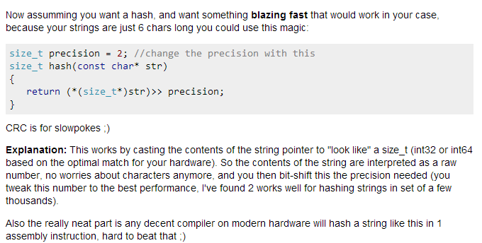
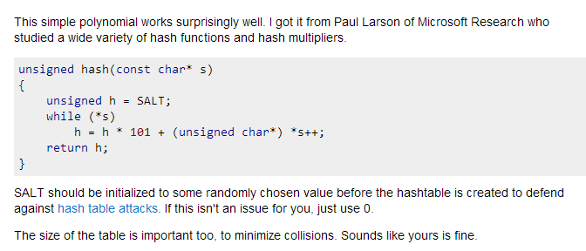

Slide 22
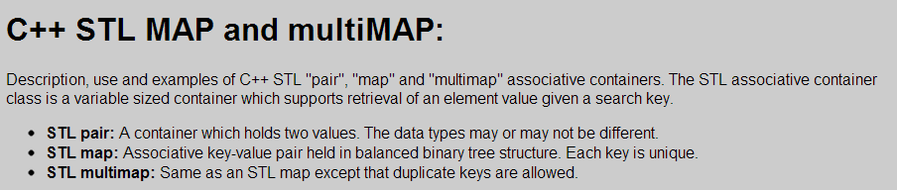
// PartDeux.cpp : Defines the entry point for the console application.
//
#include "stdafx.h"
#include <string>
#include <iostream>
#include <map>
#include <utility>
using namespace std;
int main()
{
map<int, string> Employees;
map<string, int> EmployeesbyName;
EmployeesbyName["Shawn"] = 222;
cout << "EmployeesbyName[\"Shawn\"] = " << EmployeesbyName["Shawn"] << endl;
// 1) Assignment using array index notation
Employees[5234] = "Mike C.";
Employees[3374] = "Charlie M.";
Employees[1923] = "David D.";
Employees[7582] = "John A.";
Employees[5328] = "Peter Q.";
cout << "Employees[3374] = " << Employees[3374] << endl << endl;
cout << "Map size: " << Employees.size() << endl;
for( map<int,string>::iterator ii=Employees.begin(); ii!=Employees.end(); ++ii){
cout << (*ii).first << ": " << (*ii).second << endl;
}
return 0;
}

Slide 23
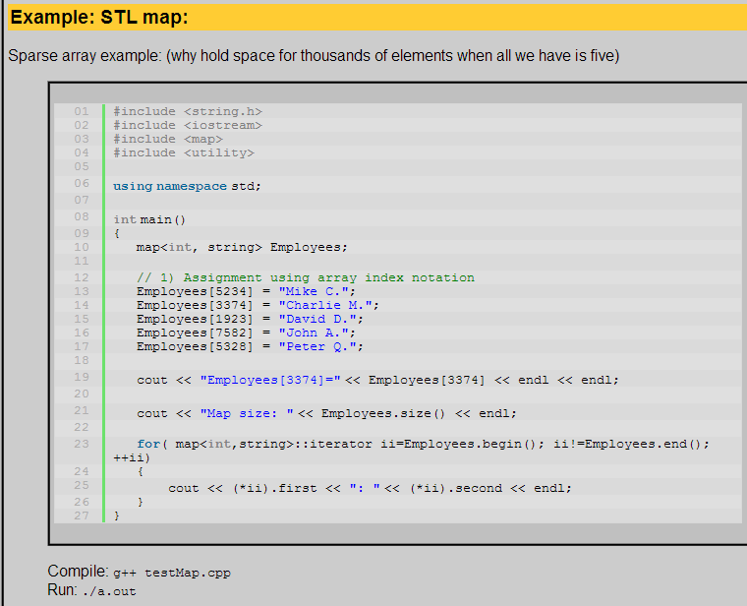

Slide 24
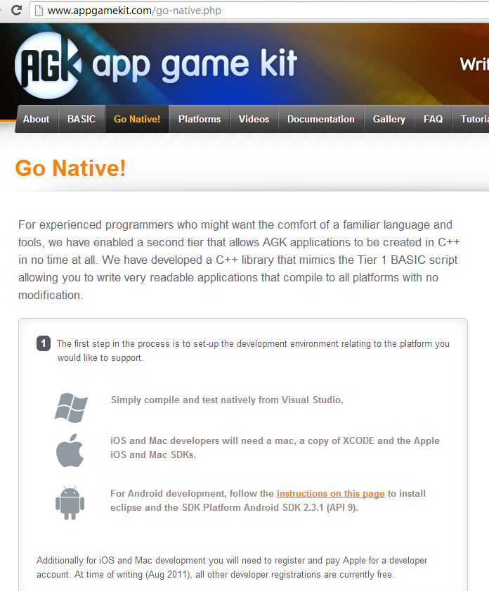
Cross-platform Game Development API’s

Slide 25
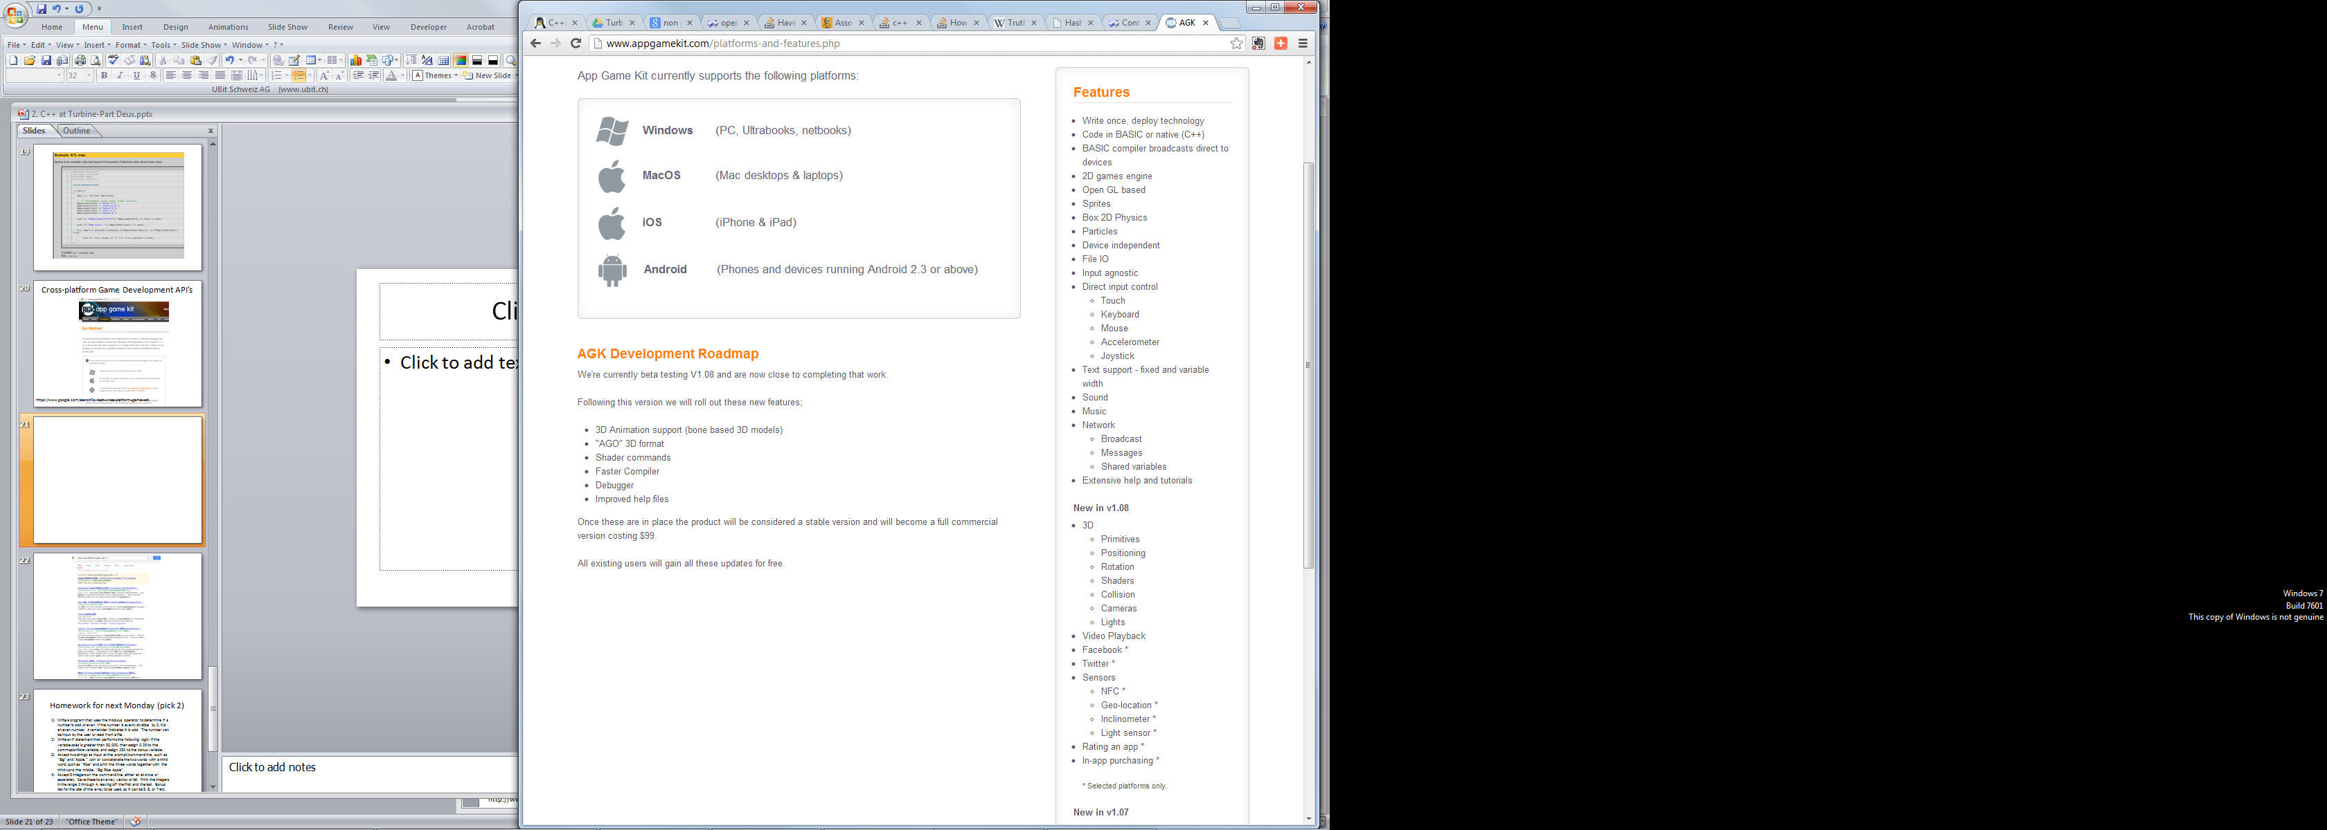

Slide 26
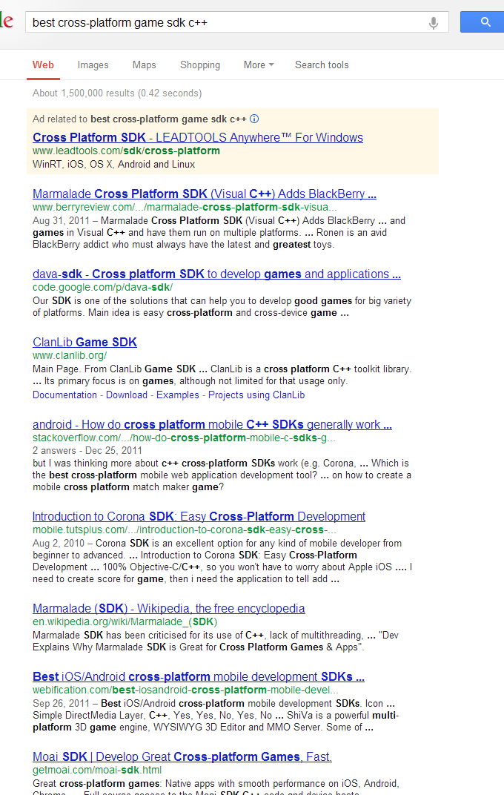

Slide 27
Homework for next Monday (pick 2, minimum)
Write a program that uses the modulus operator to determine if a number is odd or even. If the number is evenly divisible by 2, it is an even number. A remainder indicates it is odd. The number can be input by the user or read from a file.
Write an if statement that performs the following logic: if the variable sales is greater than 50,000, then assign 0.25 to the commissionRate variable, and assign 250 to the bonus variable.
Accept two strings as input at the prompt/command line, such as “Big” and “Apple.” Join or concatenate the two words with a third word, such as “Ripe” and print the three words together with the third word the middle, “Big Ripe Apple”.
Accept 5 integers on the command line, either all at once or separately. Save these to an array, vector, or list. Print the integers in the range 2 through 4, leaving off the first and the last. Bonus: Ask for the size of the array to be used, so it can be 5, 6, or 7 etc. Double Bonus: Allow a variable number of input numbers, stop input using a stop character or command the letter “s” say, then print all the input integers leaving off the first and the last.

